Slide 1
MSDS 610 Week 3 slide deck Jennifer Steiner

Slide 2
The ask
Diagram the Pipeline:
Create a diagram showing the steps of your data pipeline. Include:
Data extraction from the relational database.
Transformations applied (e.g., cleaning, normalization, feature engineering).
Final storage format (e.g., Parquet files, feature store, or another DB table).
Pipeline Type:
Decide whether your pipeline will be batch, streaming, or a combination.
Justify your choice based on the use case.
Data Format:
Choose a format for storing the processed data (e.g., JSON, CSV, Parquet) and explain why you chose it.
Notes:
The items that fall under ‘The Ask’ comes directly from the Week 3 assignment slide deck. I thought it would help keep me from going down the rabbit hole if I included it in the slide deck

Slide 3

The Pipeline

Slide 4
Confirm data exists in RAW
Send processed data to warehouse
Data extracted/used as csv
CDI dataset
Data import to RAW
Check for NaN’s (nulls) and ‘mitigate’ at db level
Use python to set up ML
Set up aggregate values, feature fields
Repeat
Notes:
The steps in the pipeline are:
Retrieve the data from CDI
This could possibly be done via api feed
Data initially stored n RAW schema before manipulations
This could be done via a DOS script that scans for a new file and imports automatically
Trigger stored proc or other process to mitigate null or missing values
In the effort keep data integrity, the stored proc/other processes could be triggered by the same script that scans for the csv from CDI. This will ensure that there is fresh data to process
Trigger replication or stored proc to extract aggregate/feature fields
Replication would be a valid choice, as it can be set up to remove outdated data and add deltas
Send the processed data to a data warehouse separate from the RAW schema
The updated/manipulated data can be sent to a schema that will be used for extraction by python
Extract the data (most likely using python) and store on C drive as csv
Once all manipulation and movement has completed, the python script can extract from the db and store as csv once final manipulations are done. Storing the extracted data allows for historical data to be used in training.
Set up ML
Repeat process on a cadence chosen based on need

Slide 5
Pipeline type and storage
The CDI data pipeline would work best as a batch processed data set. The base data source is only updated once a month for most data sources. Some of the data sources only update once a year. It makes little sense to use resources to process the data more frequently than once a month. Storage of the final product would be most workable in csv. This will make the results more portable and easier to use.
Notes:
The data doesn’t change often enough for the pipeline to be streaming. Once a month near the refresh date(s) for the different categories should be more than adequate. I say near because inevitably, there will be a time when the refresh date falls on a holiday or weekend or maintenance day.
The ideal process would be to create an automated ‘fetch’ script that would download the complete dataset and leave it in an accessible folder for use.

Slide 6

Data quality and data drift

Slide 7
Potential Data Quality issues
Several fields have null/NaN values.
Null/NaN can be mitigated pre extract
Correct data values could be located and data updated
What is not easily mitigated prior to extract can be inferred in python
Questions and stratifications are correlated to the data source. If for some reason, the fields are off, this will create issues in import, export and the meaning of the data.
Processing script can be set up to include data checks and the data can be rejected if the data doesn’t meet the pre set criteria
It is possible that two different data sources have ‘cross over’ in the various studies/focus areas.
An aggregate field could be added to denote if the data record has more than 1 focus area
Notes:
To mitigate the null issue, the python notebook was set up to set NaN in the DataValue feature to 0 and None in the Footnote feature to the actual text ‘None’. This eliminates the possibility of those features being discarded during processing.

Slide 8
Data Drift
This data set will likely drift due to additions and deletions of data sources, as well as the addition/update of the questions.
The drift can be detected by using the scripts that are set up for processing. The script/job can include an email sent to the data person when something is flagged.
A report can be set up that will notify the data person of anomalies in the data.
Notes:
In some ways, I feel like this part of the process needs some kind of human intervention. Simply because you can only code for so much—if this, then this, then this, etc. so on and so forth. Putting eyes on it allows the data person to assess if the values look like they should (sanity check). And yes, I get that if it’s a new data person, they won’t know.

Slide 9
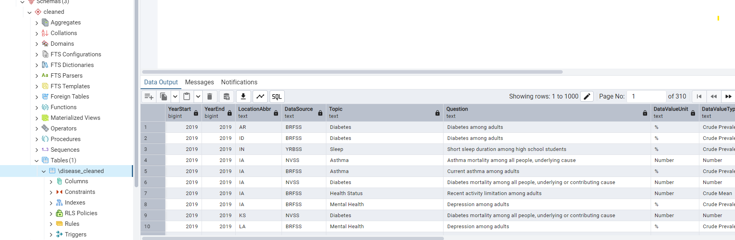
screenshot
Notes:
Yup table is there and the data is showing up.

